Slide 1

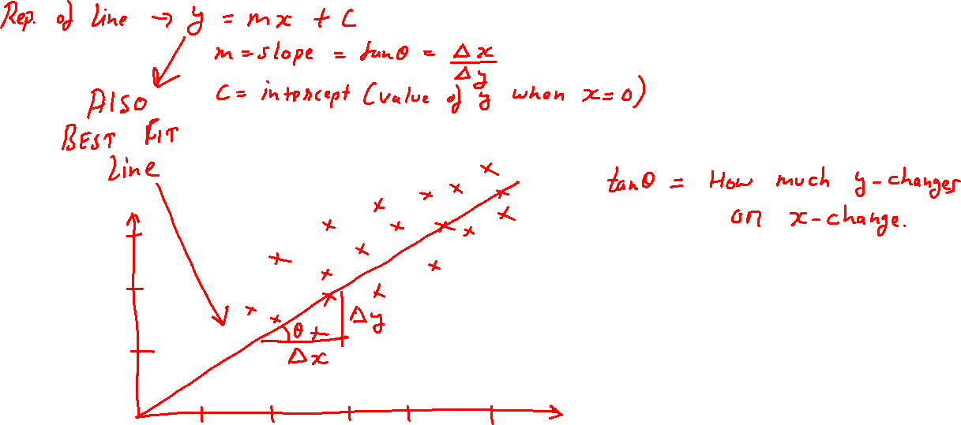

LR – Math Intuition

